Slide 1

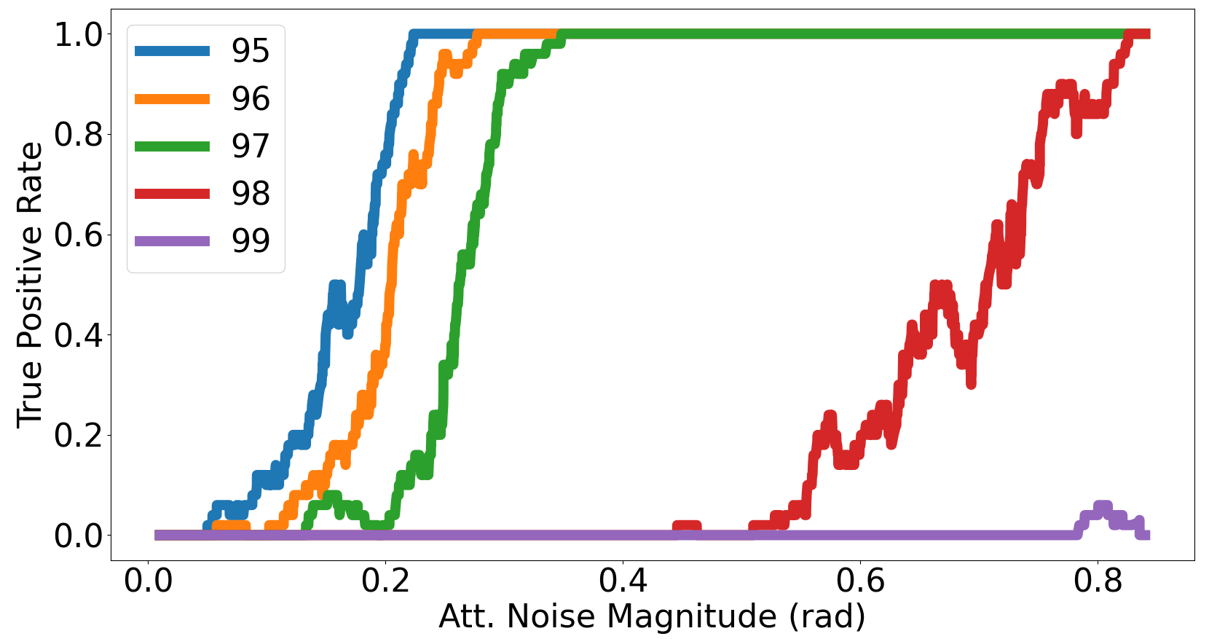
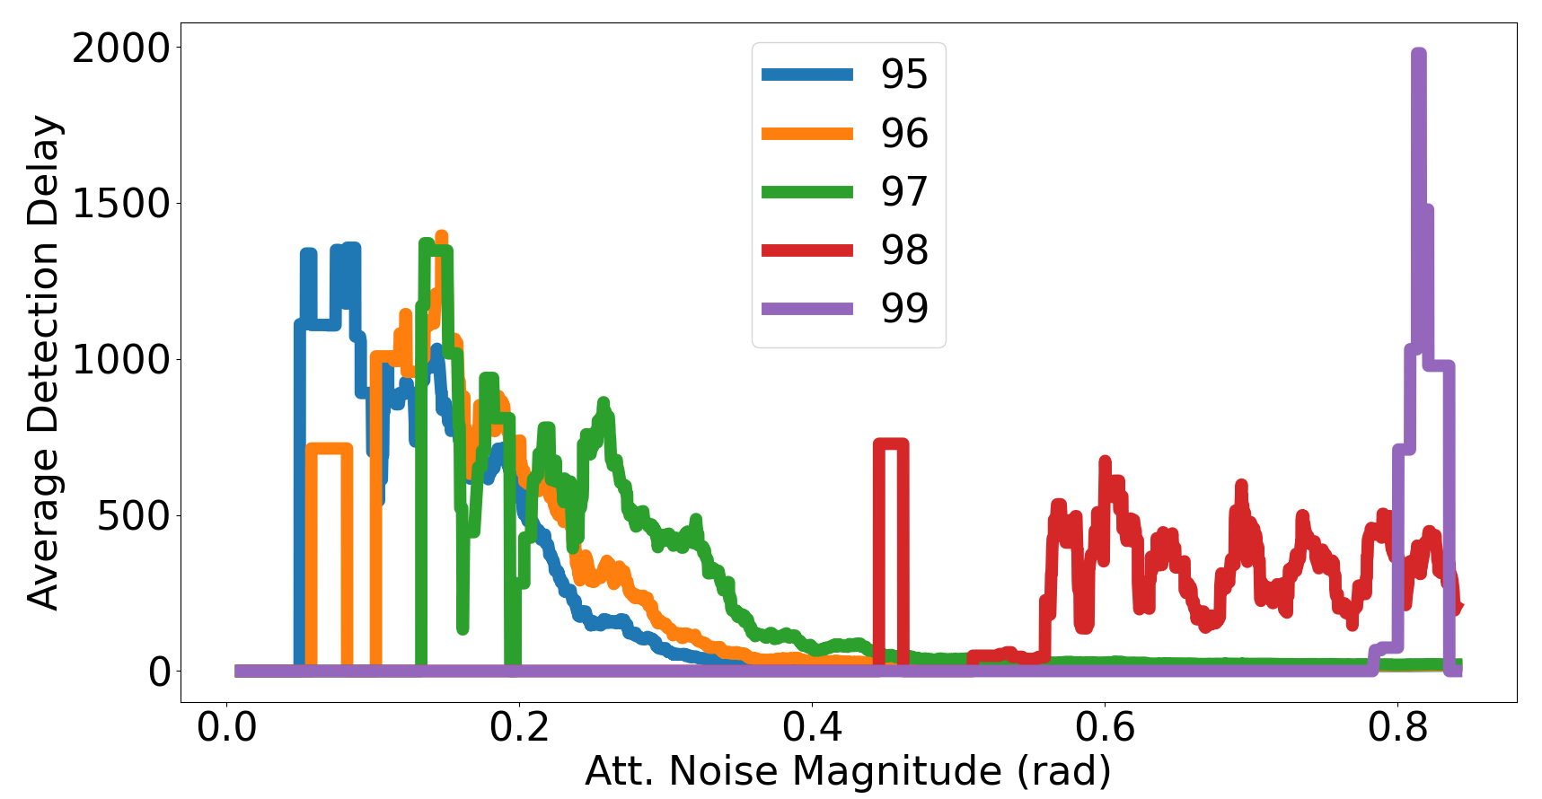
Background
Physical systems can present non-stationary behaviour, engaging in different operating conditions (modes).
Several solutions have been proposed for the control of known operating conditions of non-stationary physical systems.
Real-time adaptation to unknown operating conditions is still an open problem.
Proposed approach
We present the problem of unknown operating condition control in two steps: detection of unknown operating conditions and control tuning (parameter estimation).
Detecting unknown operating conditions
We have proposed a data driven approach to detect transtitions from known system behaviours to unknown system behaviours using a system trace as input.
Latent space representation of the observable space using a vanilla autoencoder.
Classifier-based mode identification and novel mode detection.
We propose to extend the novelty detection algorithm to inlcude information on the system performance by providing information on a loss metric as input to the detection algorithm.
Pole angle for the cartpole benchmark.
Safety volume for the quadcopter benchmark.
We propose an algorithm to detect unknown configurations which require a shift in the stable control region.
Proposed contribution
A learning-based, control tuning methodology for unknown operating conditions in non-stationary systems combining knowledge of system physics and behaviour with online measurements and using multi-model adaptive control as a basis framework for known operating conditions.
Novel mode control
Results
We have detected transitions from known to unknown operating conditions under a multimodel adaptive control framework for the quadcopter benchmark.
Reference
Multi-Controller
Control Mixing
Physical System
Novel Control Synthesis
Sensors
Detection rate increases as the parameters of the unknown configuration deviate from the conditions considered at control design time.
Multiple model adaptive control solution for known operating conditions.
Multiple low level controllers.
Learning-based control mixing.
Data-driven control synthesis for unknown operating conditions.
Reuse knowledge from control mixing by initializing novel controller search in a region close to the control produced by the control mixing block.
Detection delay decreases as the parameters of the unknown configuration deviate from the conditions considered at control design time.
Accepted Papers:
IFAC 2023: Exploring Unknown Plant Configurations under a Multiple Model Adaptive Control Framework.
Benchmarks
Cartpole
Quadcopter
Underwater Vehicle

Slide 2
Problem statement and assumptions
Given a system with known equations and fully parameterizable dynamics controlled by a multimodel adaptive control law and, given a transition in system dynamics from operating conditions known at design time into unknown operating conditions, our main goal is to estimate a low level control configuration that can produce performance guarantees for the new unknown conditions before the system enters an unrecoverable state.
Assumption 1: All system configurations (known and unknown) can be characterized by a vector of plant parameters.
Assumption 2: The impact of the transitions on system performance is recoverable, the system does not enter an unrecoverable state before the transition can be detected.
Assumption 3: All system configurations can be controlled, providing performance guarantees, by a set of control laws for which control parameters lie within a convex region.

